Slide 1
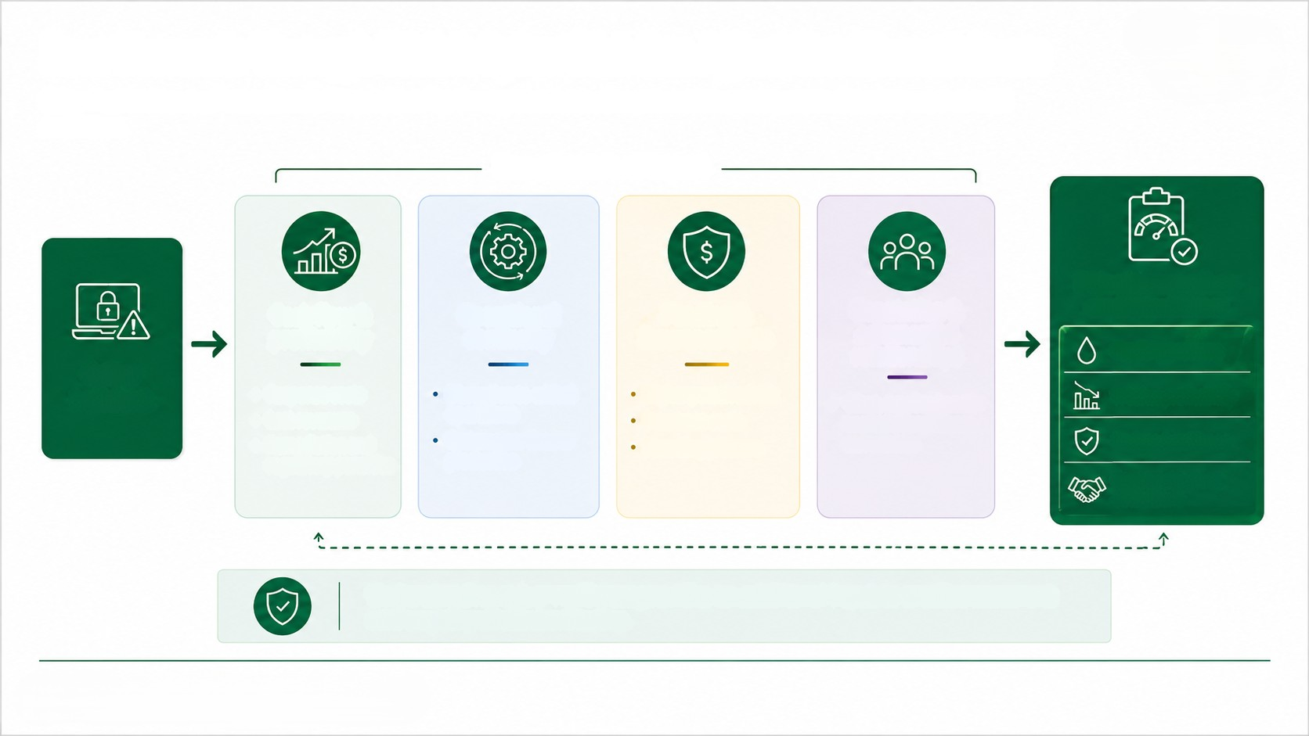
Four Channels Through Which Cyber Risk Can Affect Creditworthiness
Cyber incidents can affect a client's financial profile through business disruption, increased costs and weaker commercial
resilience.
Four channels of impact
Potential impact on
creditworthiness
Cash flow &
profitability
Operational
continuity
Funding &
insurance costs
Reputation &
commercial
relationships
Liquidity pressure
Cyber
incident
Higher perceived risk
Insurance costs
Financing pressure
• Response costs
• Lost revenues
Remediation and
regulatory penalties
Disruption to critical
operations
• Client, supplier, investor
Weaker profitability
or market confidence
can weaken
Systems, services or
production
Reduced resilience
Capacity to meet
obligations
Understanding cyber resilience provides an additional input to credit assessment
and ongoing client monitoring.

